Slide 1
Good day everyone!

Slide 2
Your Name here Your current position Name of your company, Company address

Slide 6
COMPUTER HARDWARE SERVICING NC II ( 320 Hours according to TR )

Slide 7
Data Gathering Instrument
1. Language, literacy and numeracy (LL&N)
2. Cultural and language background
3. Education & general knowledge
4. Sex
5. Age
6. Physical ability
7. Previous experience with the topic
9. Previous learning experience
10. Training Level completed
11. Special courses
12. Learning styles
13. Other needs

Slide 8
Pre-Test

Slide 9
Any Personal call?

Slide 11
What is CBT?

Slide 13
Competency-Based Training

Slide 14
What is Competency?
- It is sufficiency to satisfy the wants, the need, the qualification according to standards

Slide 15
What is CBT ?
Competency based training
is an approach to vocational education and training
emphasis on what a person can do
based on workplace experience and learning.
learning a skill is not based on time of the training but self-paced

Slide 16
Comparative Analysis between Traditional Education and CBT
TRADITIONAL | Competency Based
Instructors focus on managing instruction | Trainers focus on managing learning
Most students enter at about the same time | Trainers enter at various times throughout the year
Students all cover the same material | Different trainees maybe trained for different unit of competency within the same program
Students all proceed from one topic to the next at the same | Each trainee moves on the next task only after mastering the task he or she is currently working on

Slide 17
TRADITIONAL | Competency Based
The instructor controls the learning pace | Each trainee progress at his or her own pace
Very little continuous feedback is given | Immediate feedback is given to each trainees at critical points in the learning process
The instructor is involved in teaching only one topic at a time | The instructor must be able to answer questions on many different tasks each day
Retesting is discouraged or not allowed at all | Retesting is encouraged to reach mastery

Slide 18
TRADITIONAL | Competency Based
Materials, tools and supplies for only one topic are needed at a time | The trainer must see that all materials needed for many tasks are readily available
The number of students enrolled is maximum capacity at the beginning of the year and declines to half or less towards the end | As vacancies are filled, trainees enrolment remains at capacity all year long
Most instruction are delivered by or dependent upon the instructor | The trainer must manage the use of a wide variety of instructional media and materials each day

Slide 19
TRADITIONAL | Competency Based
The progress is usually closed down or shortened during the summer months | The program is usually operated year round
The evening program is usually separated and distinct from the day program | Day and evening program both have access to al learning guides and resources
The instructor controls the sequence in which topics will be covered | If possible, trainee determine the sequence of the tasks.

Slide 20
10 Principles of CBT
PRINCIPLE 1: The training is based on the curriculum develop from the competency standards.
PRINCIPLE 2: Learning is modular structure.
PRINCIPLE 3: Training delivery is individualized and self-paced.
PRINCIPLE 4: Training is based on work that must be performed.
PRINCIPLE 5: Training materials are directly related to the competency standards and the curriculum modules.

Slide 21
PRINCIPLE 6: Assessment of learners is based on collection of evidence of the performance of work to the industry of organizational required standards.
PRINCIPLE 7: Training is based on both on and off the jobs components.
PRINCIPLE 8: The system allows for Recognition of Prior/Current Learning. (RPL)
PRINCIPLE 9: The training allows the learners to enter and exit program at different times and levels and to receive and award for modules (competencies) attained at any point (Multiple Entry & Multiple Exit)
PRINCIPLE 10: Approved training

Slide 22
Roles of Trainees

Slide 23
Roles of the Trainees
Trainees may select what they want to learn and when they want to learn it, within reason.
2. Trainees learn at their own rate within program guidelines. They may speed up, slow down, stop or even repeat a task.
3. Trainees may request to receive credit for what they already know. This is done either through pre-testing or through a review or a task list completed at another training site.

Slide 24
4. Trainees may choose how they want to learn-individually, on a one-to-one basis, in small group, in large groups or with audio-visuals.
5. Trainees are responsible for what they learn and when they learn it.
6 . Trainees decide when they are ready to perform each task or demonstrate mastery of learning to a job-like level of proficiency before receiving credit for the task.

Slide 25
7. Trainees help develop personalized prescription for learning worked out cooperatively and based upon what the students already knows, his preference for learning, learning style and other needs.
8. Trainees compete against present job standards and not against other students and are graded on achievement of the standards or criteria of each task.
9. Trainees know "up front", before instruction begins what they are expected to know and do to complete the program.

Slide 26
10. Trainees evaluate their own progress to see how well they are doing.
11. Trainees move freely in the workshop, laboratory and or training center.
12. Trainees know they will be rated mainly on performance, while paper and pencil tests will be used mainly to check their knowledge of the task.
13. Trainees learn according to their interest, needs and abilities - not according to teacher timelines and expediency.

Slide 27
Roles of a Trainer

Slide 28
The following functions outline the role of the trainer in learner-centered instructional situations:
1. Serves as a team member to determine what is to be learned. 2. Stimulates trainee's motivation. 3. Manages learning: a consultation rather than a provider of information; a facilitator of learning. 4. Diagnose and solves learning problems. 5. Evaluates student achievement. 6. Assist learners to obtain individualized rewards.

Slide 29
7 . Assist each trainee in designing a personalized plan of study. 8. Installs confidence in the learner by providing experiences where learners may succeed. 9. Serves as a model for desirable work habits, attitudes and tasks performance in the occupational field. 10. Spends more time interacting with students on a 1:1 or small group basis. 11. Helps those students who really need help. 12. Accepts responsibility along with the student for the tasks learned or not learned.

Slide 30
House Rules

Slide 31
Do’s 1. Know the location of the fire extinguisher and the first aid box and how to use them in case of an emergency. 2. Read and understand how to carry out an activity thoroughly before coming to the laboratory. 3. Report fires or accidents to your lecturer / laboratory technician immediately. 4. Report any broken plugs or exposed electrical wires to your lecturer / laboratory technician immediately.

Slide 32
Don’ts 1. Do not eat or drink in the laboratory. 2. Avoid stepping on electrical wires or any other computer cables. 3. Do not open the system unit casing or monitor casing particularly when the power is turned on. Some internal components hold electric voltages of up to 30000 volts, which can be fatal. 4. Do not insert metal objects such as clips, pins and needles into the computer casings. They may cause fire. 5. Do not remove anything from the computer laboratory without permission. 6. Do not touch, connect or disconnect any plug or cable without your lecturer / laboratory technician’s permission. 7. Do not misbehave in the computer laboratory.

Slide 33
Different Components or Area of Competency-Based Facility

Slide 34
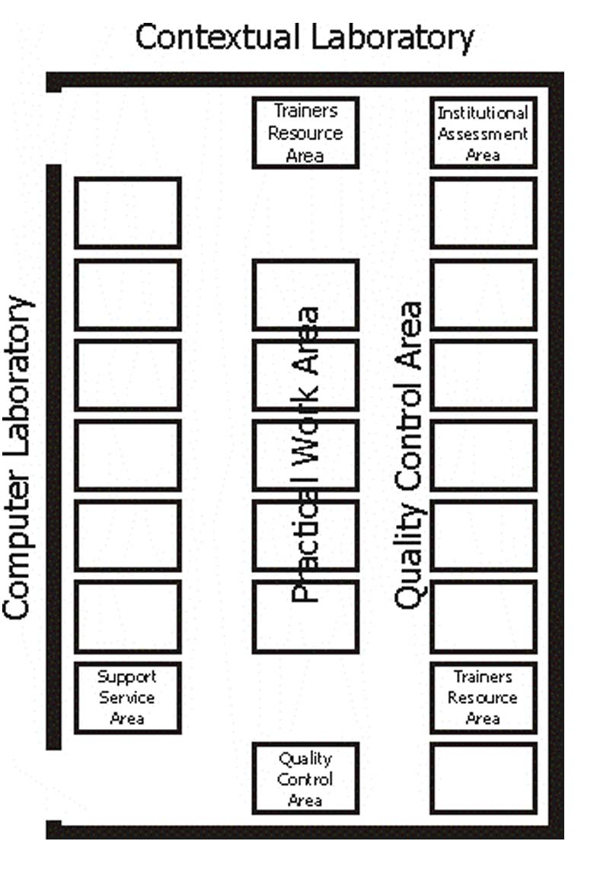
1. Practical Work Area 2. Learning Resource Area 3. Institutional Assessment Area 4. Contextual Laboratory 5. Quality Control Area 6. Trainer’s Resource Area 7. Distance Learning 8. Computer Laboratory 9. Support Service Area
4
6
3
2
7
1
8
9
6
5

Slide 35
Insert your PROGRESS CHART here

Slide 36
Insert your ACHIEVEMENT CHART here

Slide 37
Insert your TRAINING MATRIX here

Slide 38
CHS Units of Competencies
For Grade 9
ELC724318 (Core 1) Install computer systems and networks LO1. Plan and prepare for installation LO2. Install equipment/device system LO3. Conduct test
ELC724319 (Core 2) Diagnose and troubleshoot computer systems LO1. Plan and prepare for diagnosis of faults of computer systems LO2. Diagnose faults of computer systems LO3. Repair defects in computer systems and networks LO4. Test systems and networks

Slide 39
For Grade 10
ELC724320 (Core 3) Configure computer systems and networks LO1. Plan and prepare for configuration LO2. Configure computer systems and networks LO3. Inspect and test configured computer systems and networks
ELC724321 (Core 4) Maintain computer systems and networks LO1. Plan and prepare for the maintenance of computer systems and networks. LO2. Maintain computer systems LO3. Maintain network systems LO4. Inspect and test configured/repaired computer system and networks

Slide 40
THANK YOU

